Slide 1

Two Transformers Can Make One Strong GAN
TransGAN
김영민 김지수 이다인

Slide 2




1. 최근 동향
Transformer
멸종 위기 CNN
MLP
최적화 잘 못함
세부정보 손실 발생 시킴
Generation
아직도 CNN이랑
손절 안했대..
CNN
Classification
Segmentation
Detection

Slide 3
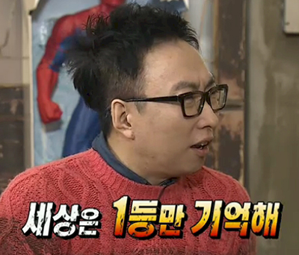
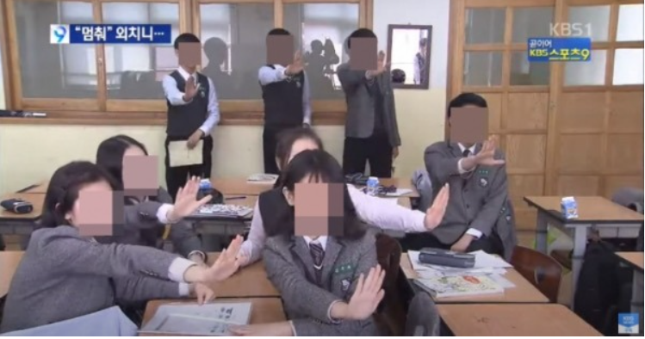

2. Contribution
1. Convolution layer 멈춰!
2. memory-friendly Transformer
3. SOTA!
Generator based on Memory friendly Transformer
GAN completely
free of convolution
STL-10
FID,IS 1st

Slide 4


3. Charm of Transformer
Transformer
1. It has strong representation capability and is free of human-defined inductive bias.
2. the transformer architecture is general, conceptually simple and has the potential to become a powerful “universal” model across tasks and domains

Slide 5
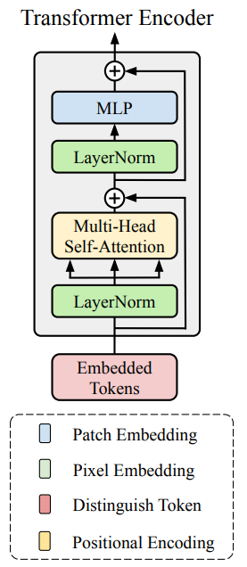

4. A Journey Towards GAN with Pure Transformers
Transformer Encoder
As Basic Block
MLP with GELU
Multi-head Self-Attention
Residual Connection
Normalization layer
Minimize Change
Transformer

Slide 6
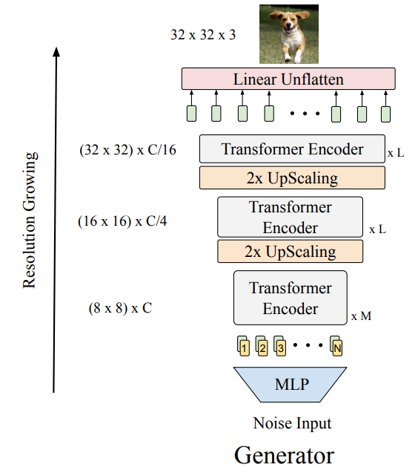


4. A Journey Towards GAN with Pure Transformers
Memory-Friendly
Generator
PixelShuffle method
멈춤 조건
$$W_{T}=W{,H}_{T}=H$$
Pseudo
code
While W_t == W and H_t == H:
W *= 2
H *= 2
C *= 1/4
Resolution = W * H * C
Resolution = W_t * H_t * 3

Slide 7
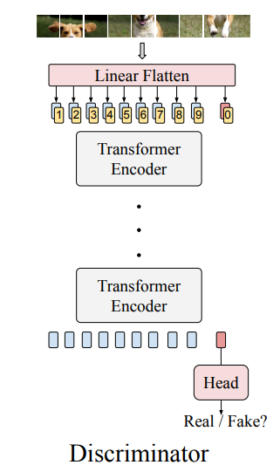
4. A Journey Towards GAN with Pure Transformers
Tokenized-Input for
Discriminator
Patch-Level Tokenizing
Reshape 1d sequence
Predict Real/Fake
[CLS] token

Slide 8
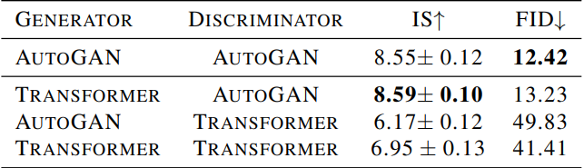
4. A Journey Towards GAN with Pure Transformers
Result
Dataset = CIFAR-10
Paper method
Transformer G -> Good Performance
But, Transformer D -> Bad Performance

Slide 9
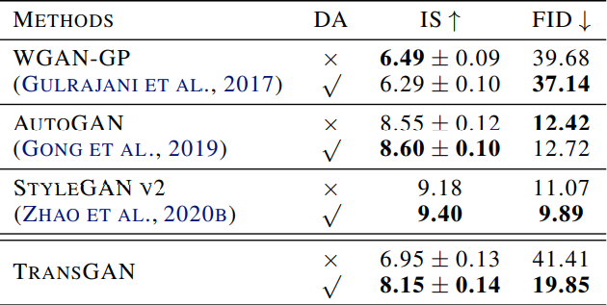
5. Data Augmentation is Crucial for TransGAN
Few-shot
좋은 생성 모델로 만든 가짜 이미지로 데이터 증강을 하는 방법
Data Augmentation을 통해 눈에 띄는 성능 향상!

Slide 10
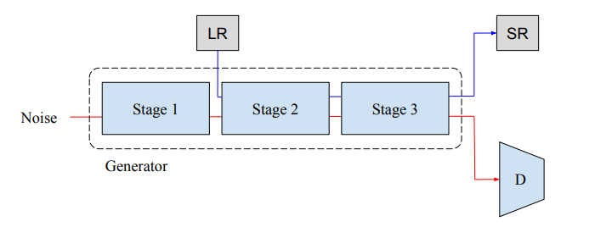
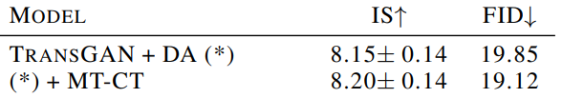
6. Co-Training with Self-Supervised Auxiliary Task
MT-CT
Multi-Task Co-Training
GAN loss + Supper Resolution 보조 task

Slide 11
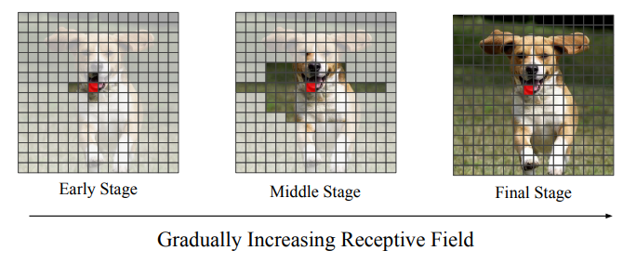
7. Locality-Aware Initialization for Self-Attention
Local Initialization
without Convolution
Regularizer 역할
우선순위를 갖게 함
Provide
More detail
&
noise
Provides necessary details

Slide 12
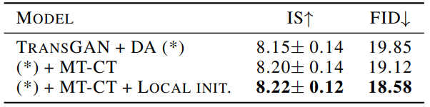
7. Locality-Aware Initialization for Self-Attention
Result

Slide 13
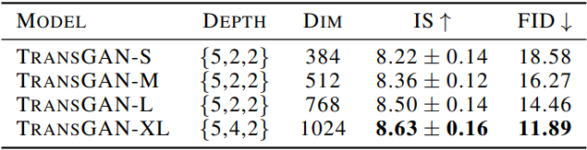
8. Scaling up to Large Model
Model
S : 384x384
M : 512 x 512
L : 768 x 768
XL : 1024x1024
Number of Encoder Block

Slide 14

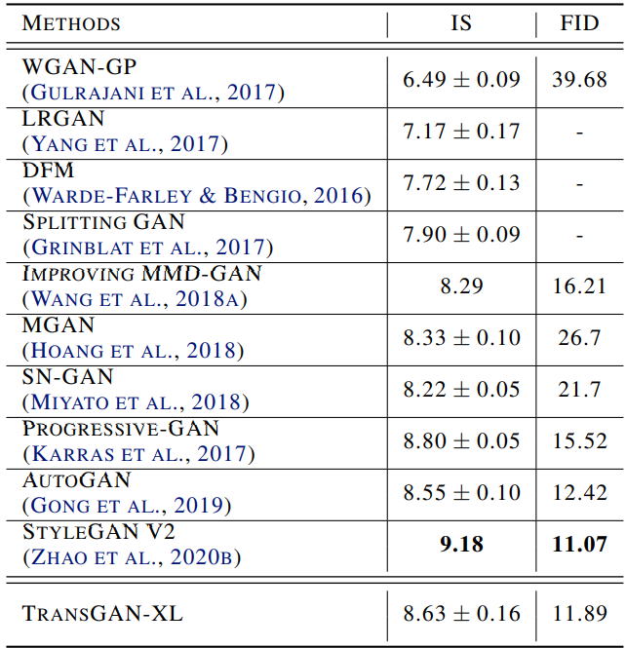
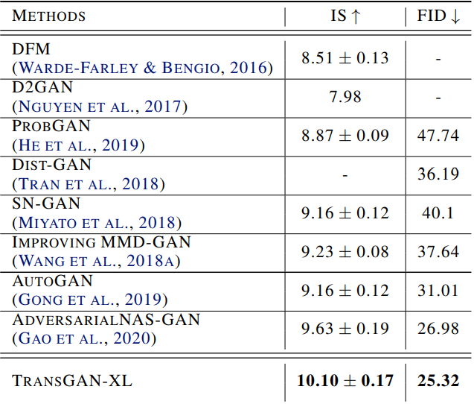
9. Comparison with State-of-the-art GANs
CIFAR-10
STL-10
SOTA!!
FID 2등!
IS, FID 1등!

Slide 15
감사합니다

